Slide 1

WEB TECHNOLOGIES
HTML 5
Vinay Joshi
Department of
Computer Science and Engineering

Slide 2
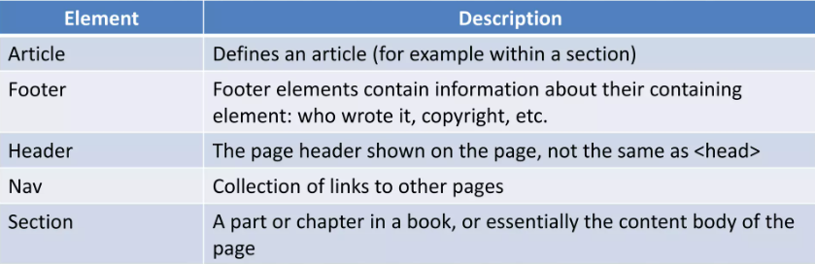
HTML5
Introduction
HTML5 ~= HTML + CSS3 + JavaScript API
Future of the web
It comes with new tags, features and APIs
HTML5 introduces 28 new elements such as: <header>,<footer>,<article>,<nav>,<section>,<time>,<audio>,<video>,<output> etc..
The main structural elements are as follows:
Notes:
Bottom three features are covered in Unit 2.

Slide 3
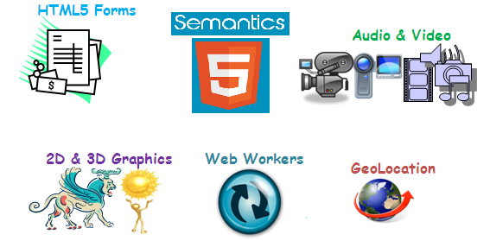
HTML5
Features
Notes:
Bottom three features are covered in Unit 2.

Slide 4
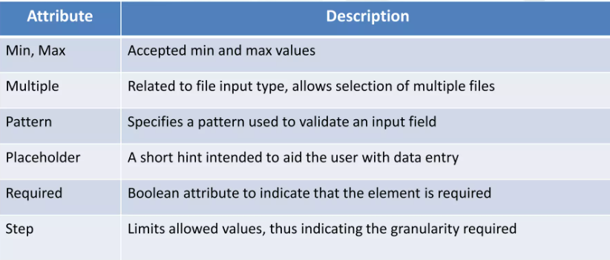
HTML 5
Forms – New Input Widgets
HTML5 specifications introduced new Input types and properties
New Input Types:
email: email address
number: spinbox
range: slider
url: web addresses
color: color pickers
search: search boxes
date: date
time: time
file: input file selection
Tel: phone no.
New Input properties / Attributes:

Slide 5
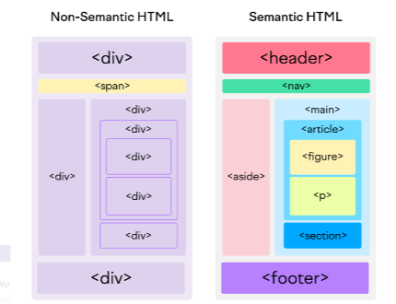
HTML 5
Semantic Elements

Slide 6
HTML 5
Semantic Elements
In earlier versions of HTML, there were no globally accepted names for structural elements, and each developer used their own. That made it very hard for search engines to index web page content correctly.
When a browser communicates with the code, it looks for some specific information to help with the display.
Hence, HTML5 introduced a consistent list of semantic elements to help search engines and developers.

Slide 7
XML Vs JSON HTML5
What are HTML5 semantic elements ?
Creating semantic elements in HTML5 is to give meaning to its traditional design layout.
It helps browsers quickly and efficiently understand the structure of the layout, and two, it helps web developers to systematically arrange or design web pages and give meaning to each section of the layout.
The elements are easy to remember, and fits where it needs.

Slide 8
THANK YOU
Vinay Joshi
Department of Computer Science and Engineering
vinayj@pes.edu
+91 80 2672 6622

